Slide 1
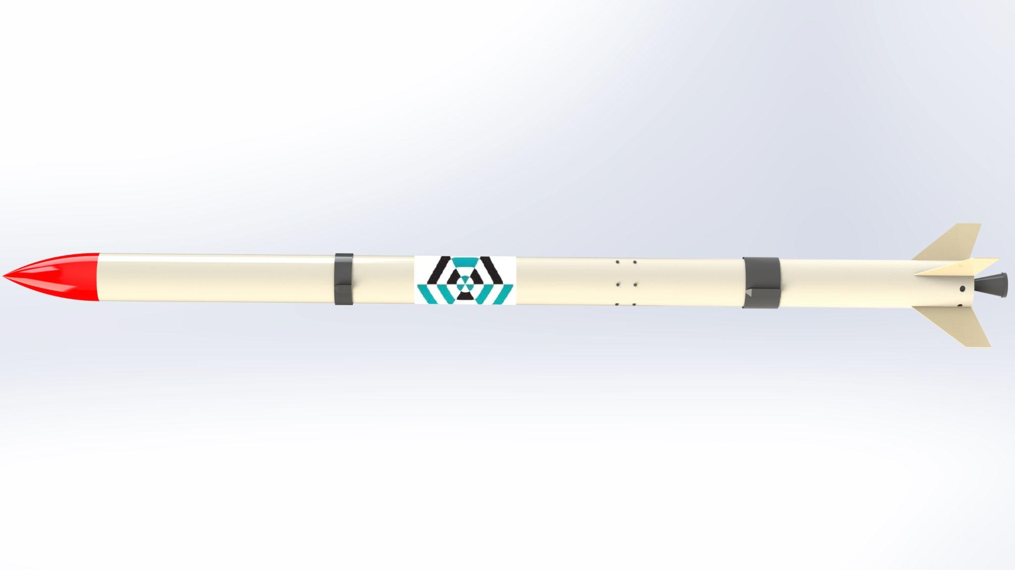
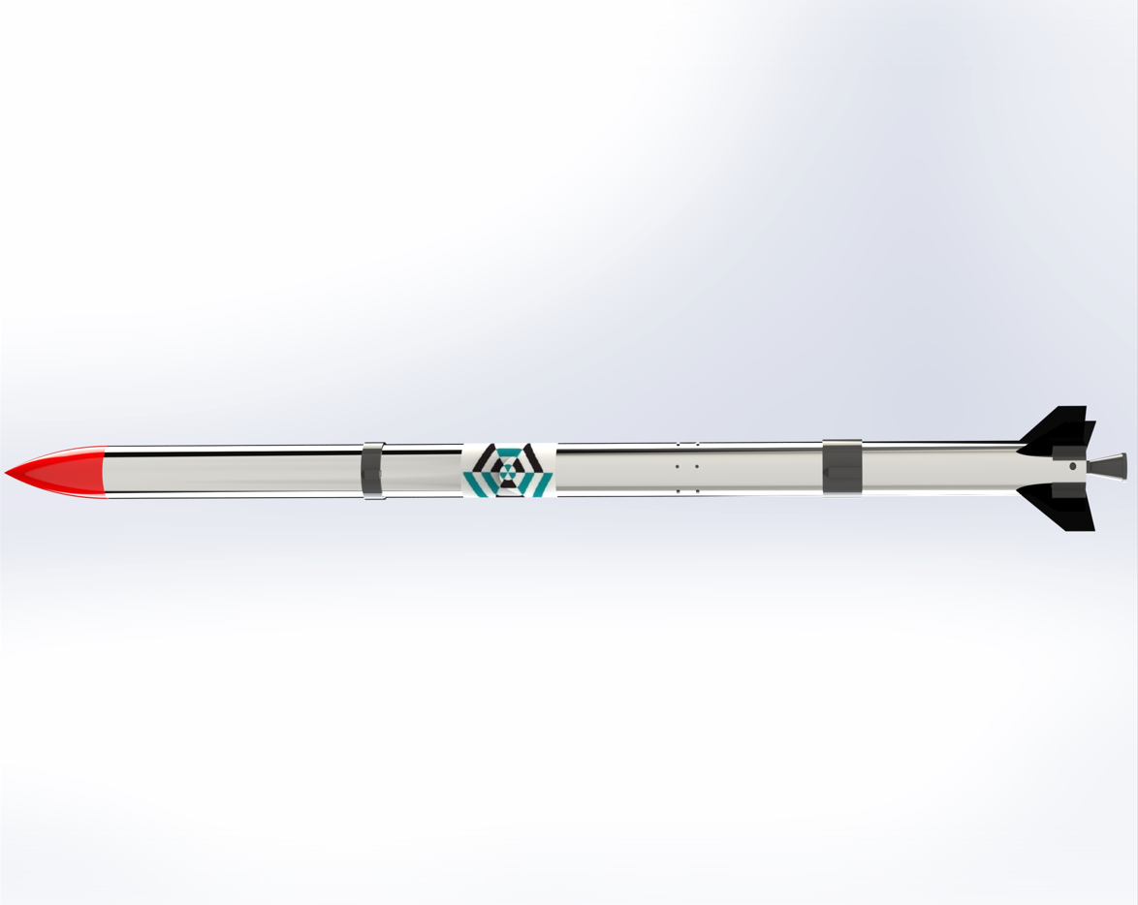
Airframe Progress Report
-22/3/2023-
no_reply@example.com

Slide 2
OVERVIEW
Fabrication of Aluminum #20
Fabrication of the fin alignment jig
Design and fabrication of internal components (Avionics bay and Coupler)

Slide 3
Fabrication of Aluminium Airframe
The top and bottom sections of the airframe were rolled.
However, the aluminium airframe could not be completed due to lack of rivets and thus they are left in their rolled state.
#20

Slide 4
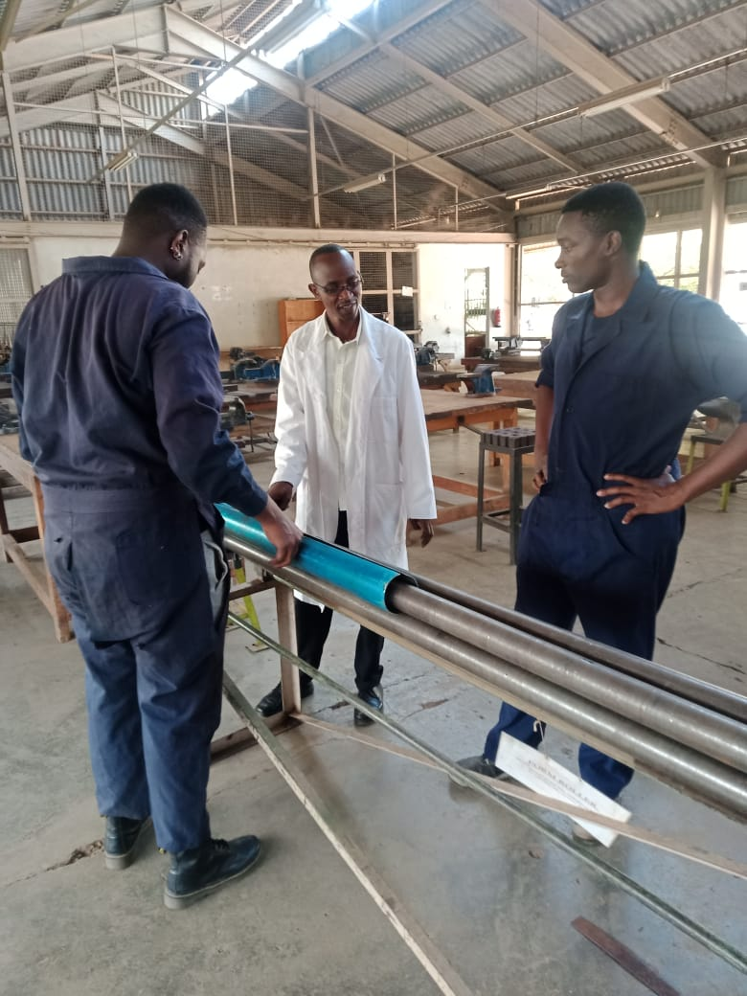
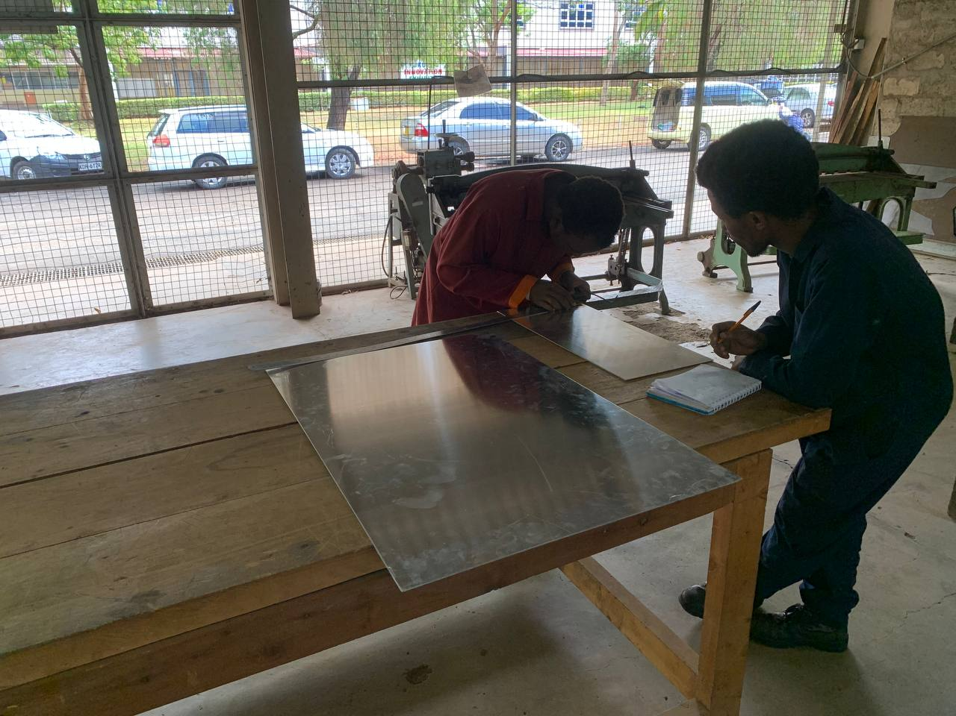
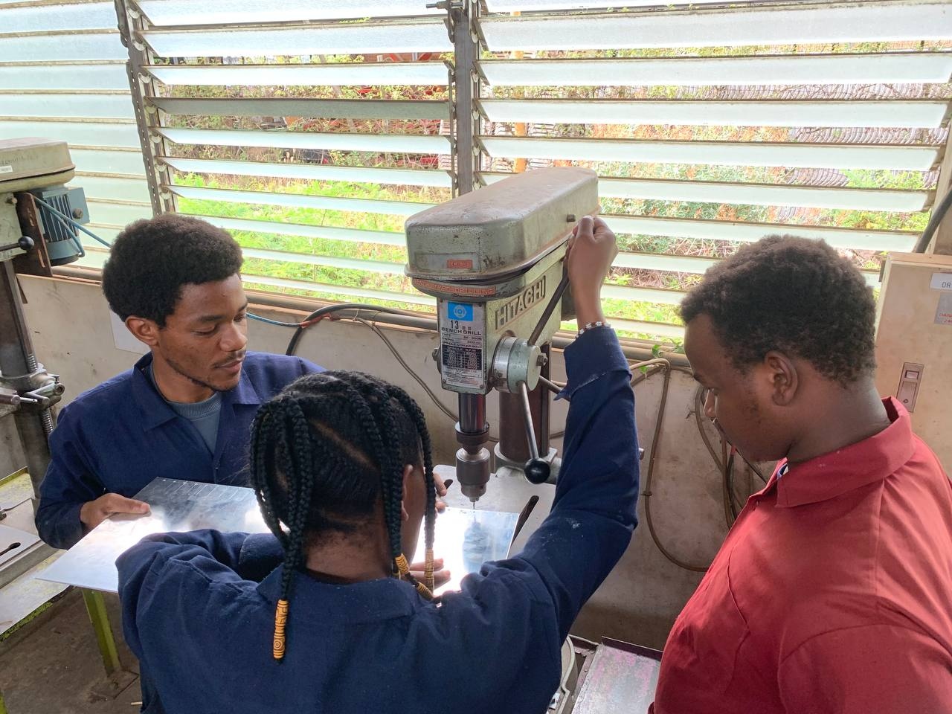
PROCEDURE
Marking out points to be drilled
Drilling
Rolling

Slide 5
Challenges encountered
Fabrication of the fiberglass airframe was halted due to the depletion of epoxy which will be procured.
Once procured, the tail fins of the fiberglass airframe together with other body tubes shall be fabricated.

Slide 6
Fabrication of the fin alignment jig

Slide 7
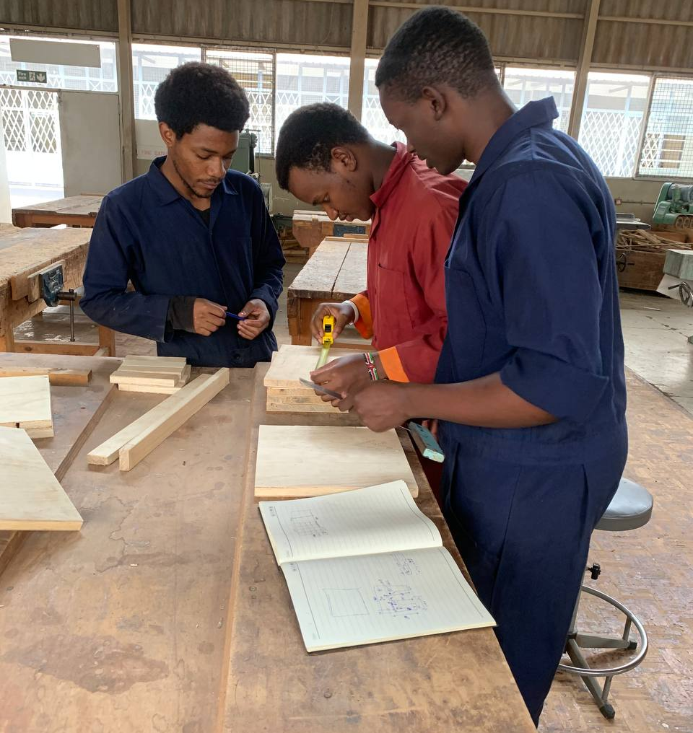
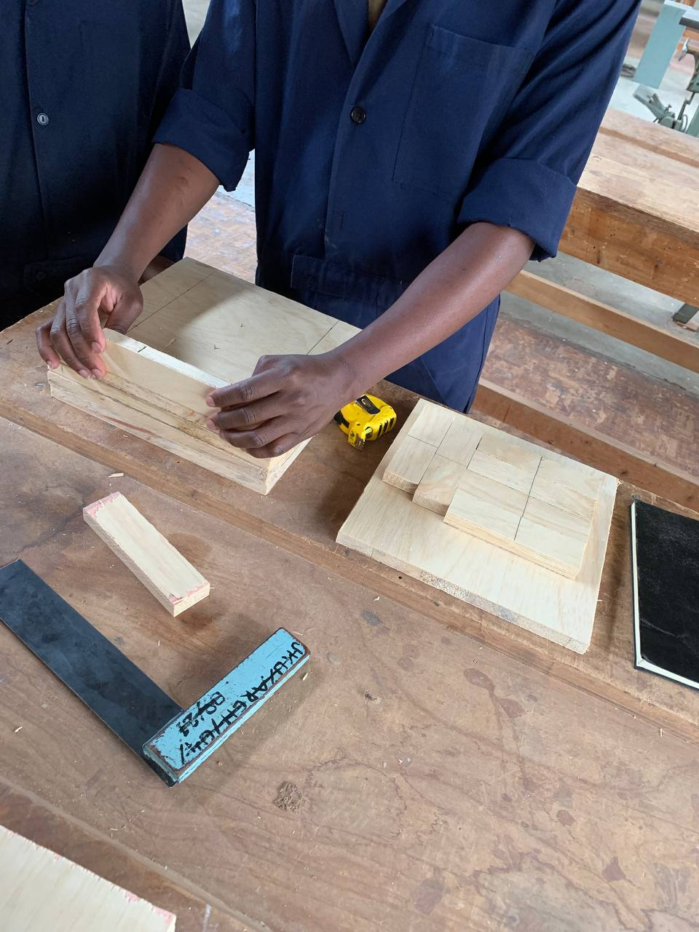
The outline of all the fin alignments jig have been marked out and will be machined by tomorrow.

Slide 8
Redesign of the internal components

Slide 9
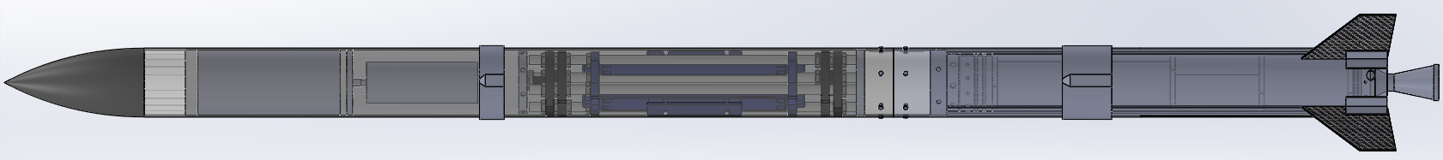
Coupler
The coupler connecting the avionics body tube and the motor tube has been fabricated with PLA. This component will support the avionics bay at the base and where fasteners from the body tube will be placed
Weight = 237g
Total length = 90mm
Thickness = 75mm

Slide 10
NEXT WEEK’S OBJECTIVES
Finalization of the aluminium airframes
Fabrication of fiberglass airframe
Fabrication of parachute

Slide 11
THANKYOU
Q/A

